Slide 1
Is popular dance beautiful?
A method to assess pleasure in dance
Julia Gleich
Gleich Dances
London Studio Centre
Trinity Laban Conservatoire
Denis Pelli
Professor of Psychology and Neural Science
New York University
PoP MOVES: Dancing the politics of pleasure
Royal Holloway, University of London, Saturday 18th October 2014

Slide 2
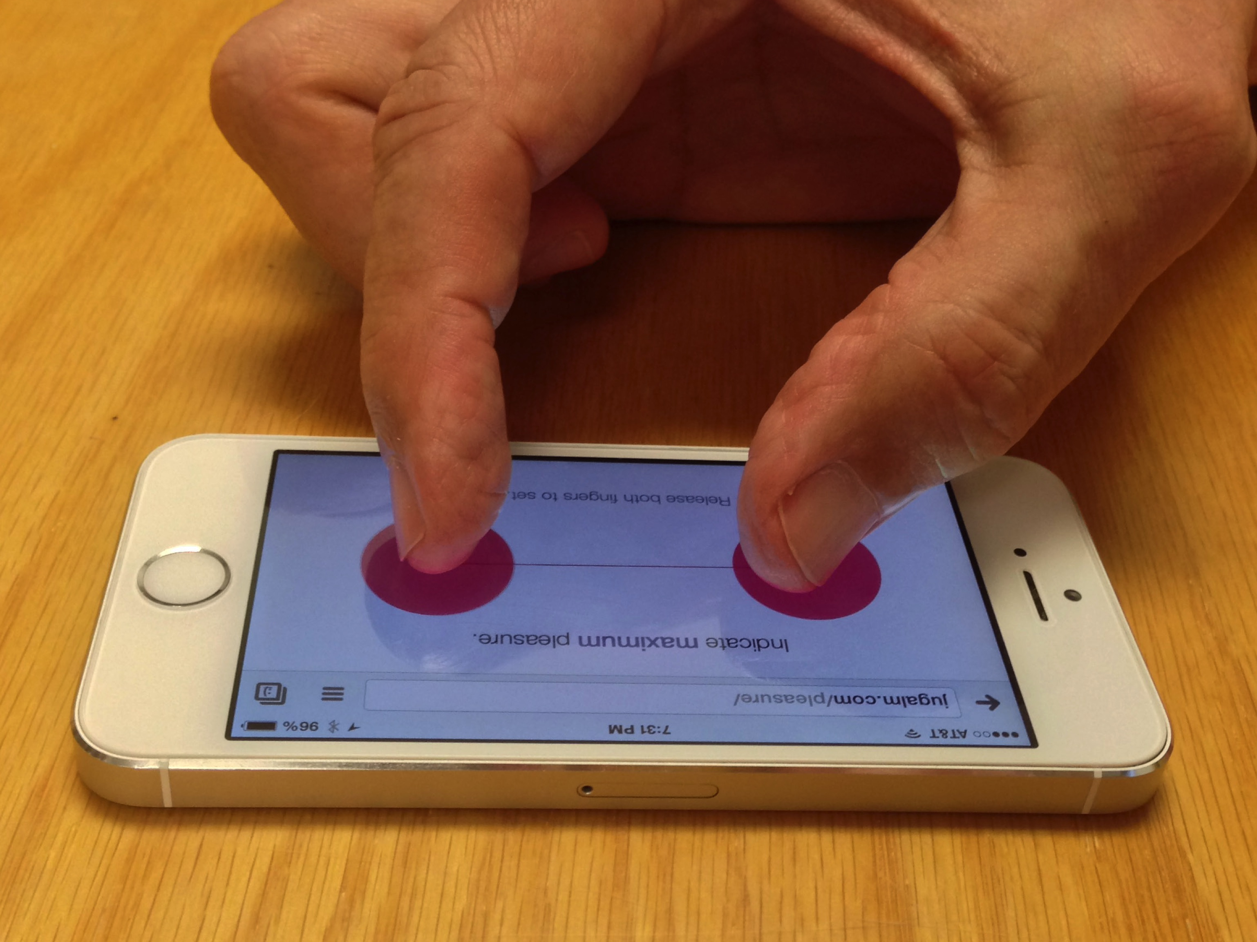
Using the Pleasure Tracker app
Pelli & Vale IAEA 2014 google “pelli posters”

Slide 3
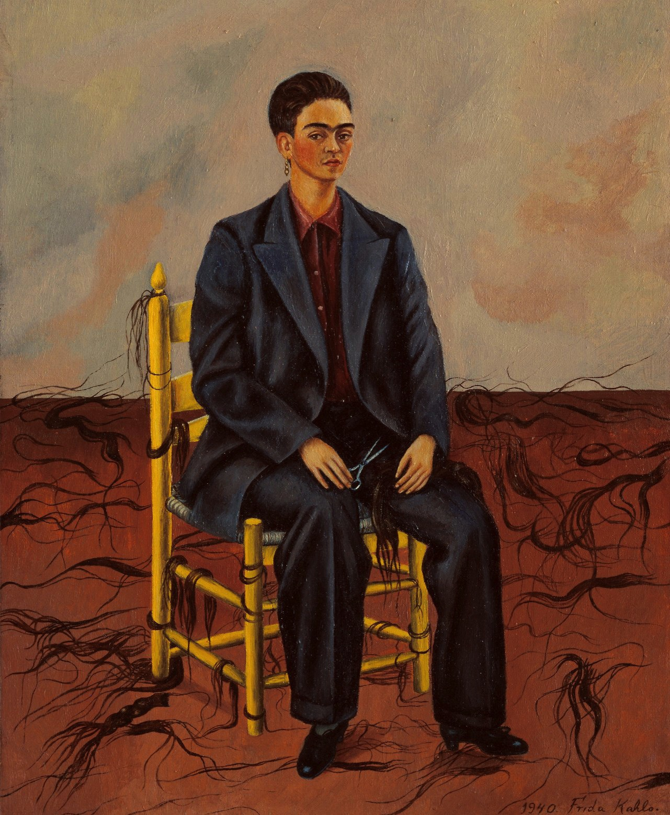

Pleasure decays exponentially
Pelli & Vale IAEA 2014 google “pelli posters”

Slide 4
The feeling of beauty is associated with high lingering pleasure.
Pelli & Vale IAEA 2014 google “pelli posters”

Slide 5
Pleasure is 78% correlated with the feeling of beauty.
Pelli & Vale IAEA 2014 google “pelli posters”

Slide 6
http://pleasuretracker.net
Device: iPhone, iPad, or Android.
Browser: Chrome.
Other browsers might work. Avoid Safari and Firefox.

Slide 7
http://pleasuretracker.net
Name: Enough to be unique.
Experiment: Default.

Slide 8
Before we start, we must calibrate your fingers. Use two fingers, your first finger and your middle finger. When you put them on the screen, pink dots will track them. You indicate pleasure continuously over time by adjusting the spread of your fingers. When we calibrate, you indicate maximum pleasure by spreading your fingers as wide as you can comfortably maintain. When you find the right spread, record it by lifting your fingers away from the screen.

Slide 9
Then you’ll indicate minimum pleasure by relaxing your fingers, allowing them to adopt a natural position, effortless. After you calibrate then there will be two chances to practice setting max and min again. Then wait.

Slide 10
Once your fingers are calibrated, please
WAIT!
So we can all start together.

Slide 11

Cue up movie to start with knees on ground at 1:55. Has sound.

Slide 12
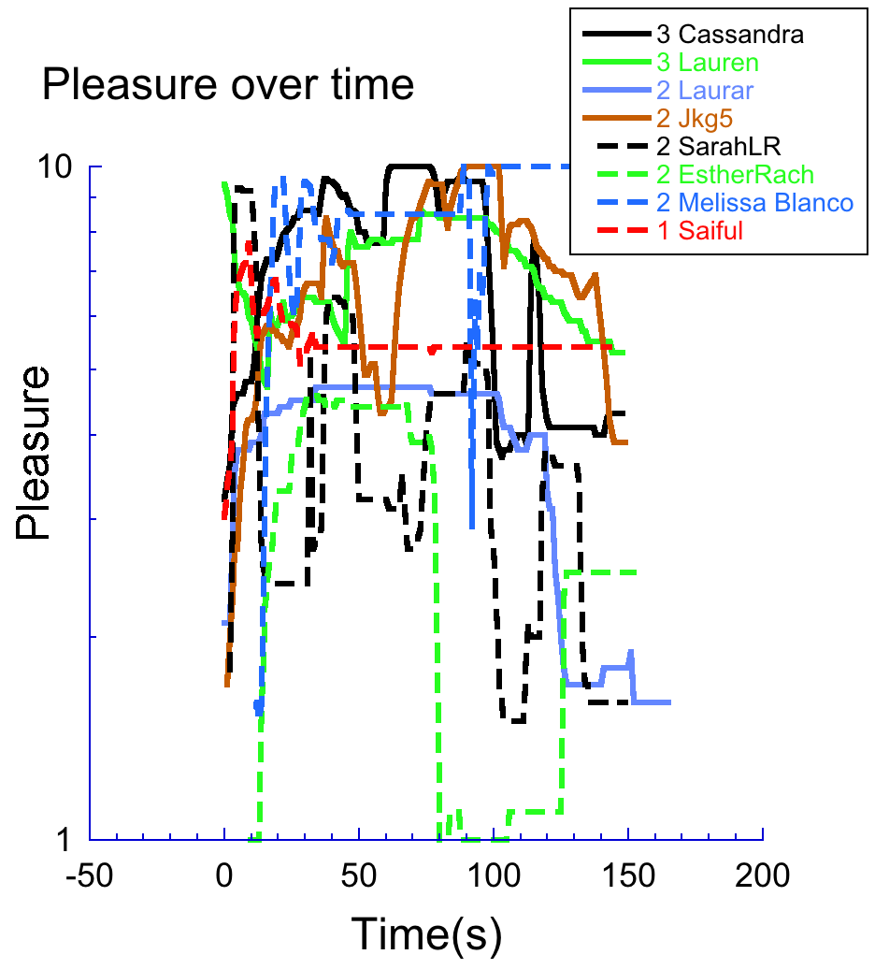

Slide 13
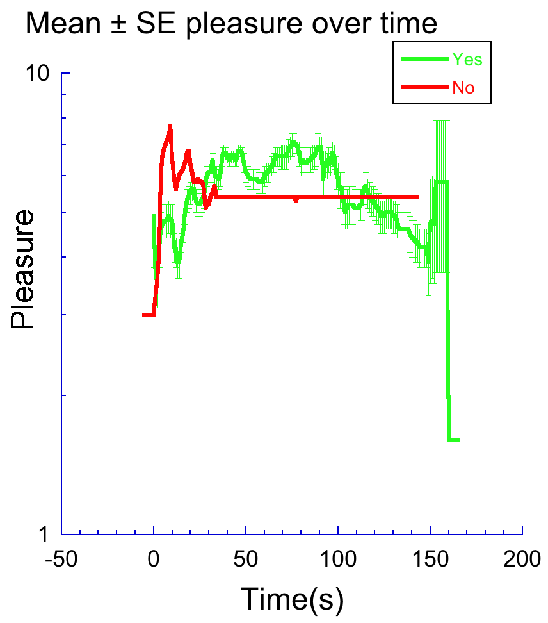

Slide 14
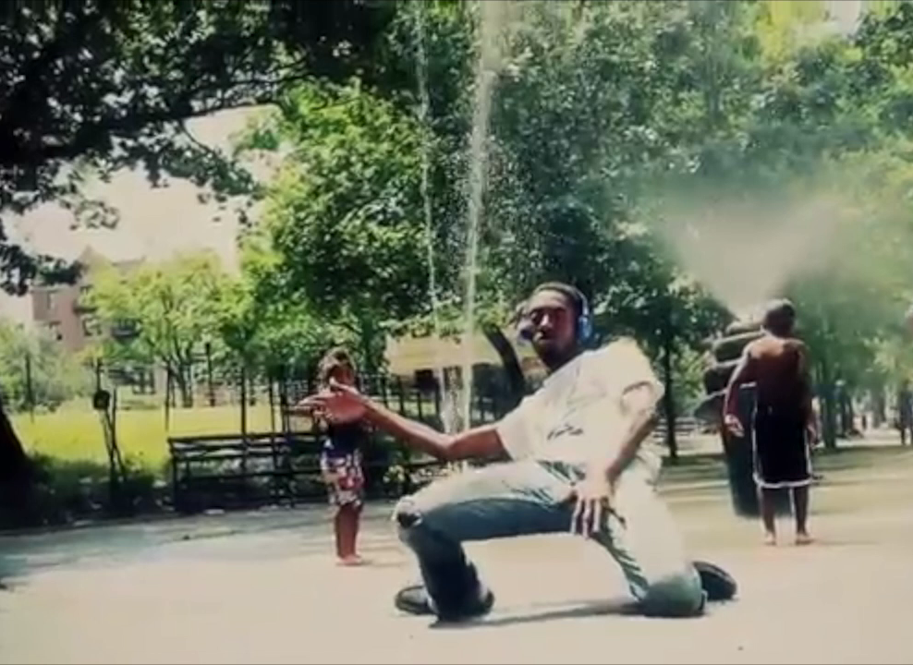
4x speed
Silent. Quickly click movie and animation to start them together.

Slide 15
Thank you.
http://pleasuretracker.net

Slide 16
Pleasure, measured in 3 ways, is consistent.
Pelli & Vale IAEA 2014 google “pelli posters”

